Slide 1
SWADN Framework
Developers point of view

Slide 2
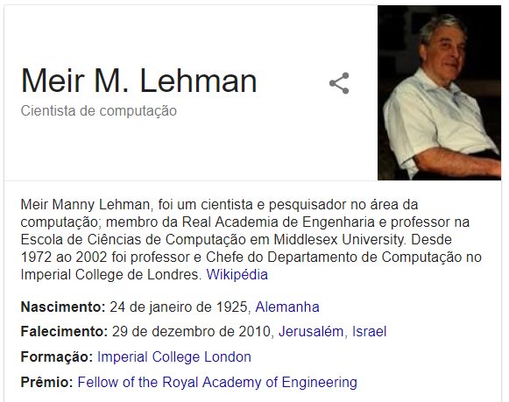
"An evolving system increases its complexity unless work is done to reduce it." - Meir Lehman

Slide 3
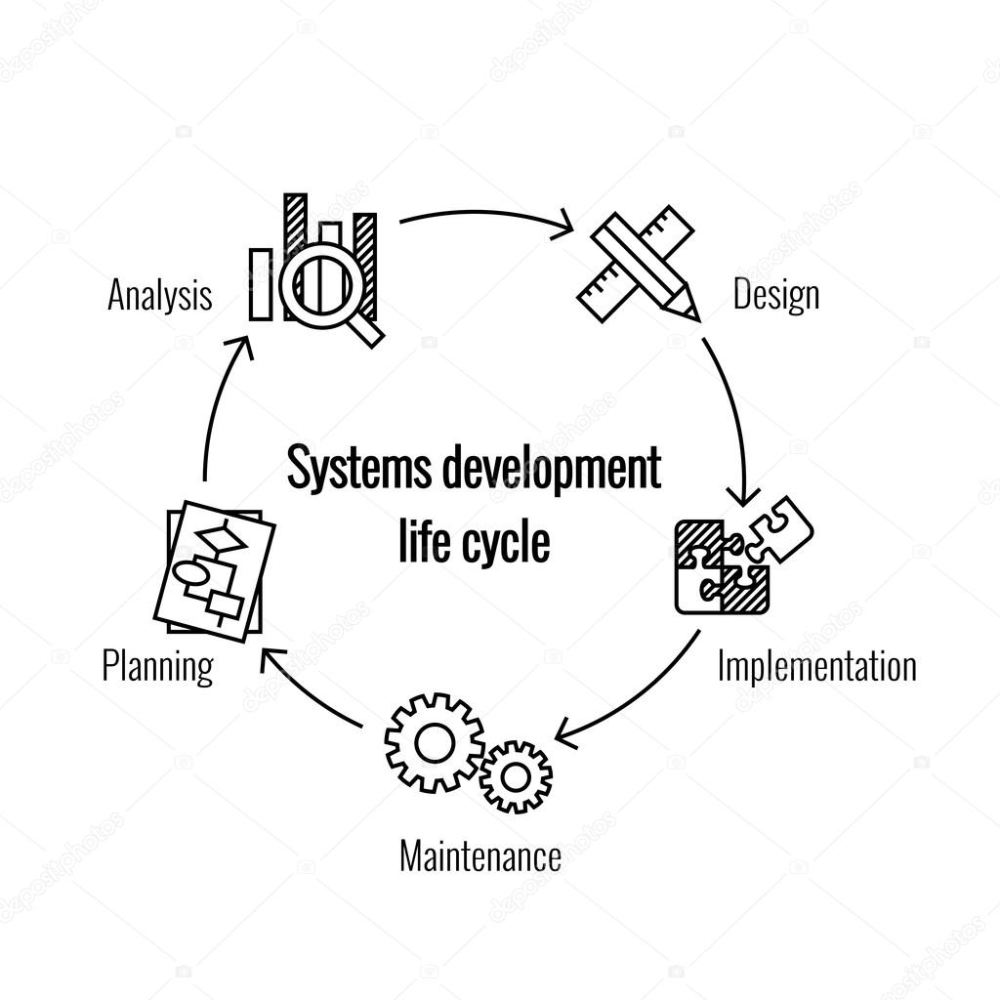
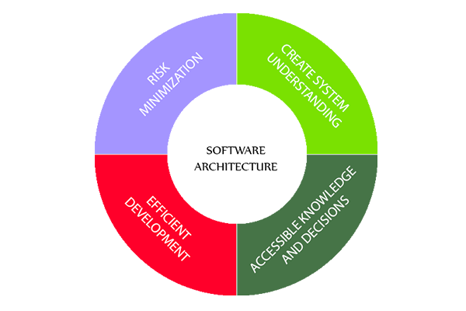

Code Base
Development
Cycle
Software
Arquitecture
Team Culture

Slide 4
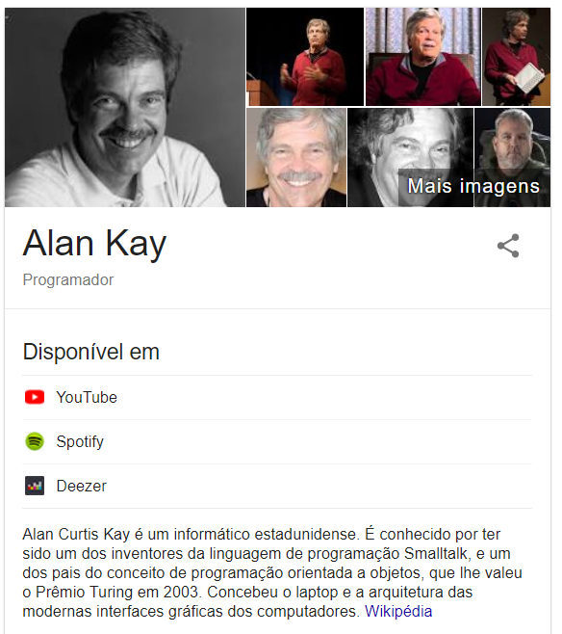
The best way to predict the future is to invent it
People who are really serious about software should make their own hardware.

Slide 5
Improvements Code base
Clean and explicit separation by logic domain
Maintainability
Documentation
Readability

Slide 6
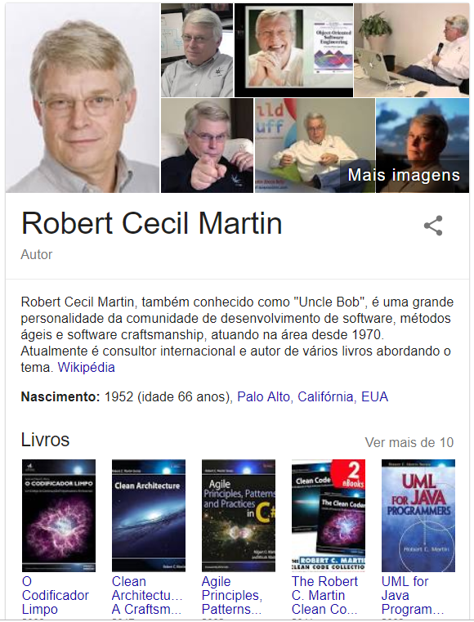
“In an ideal system, we incorporate new features by extending the system, not by making modifications to existing code.” ― Clean Code: A Handbook of Agile Software Craftsmanship
“If the discipline of requirements specification has taught us anything, it is that well-specified requirements are as formal as code and can act as executable tests of that code!”
― Clean Code: A Handbook of Agile Software Craftsmanship

Slide 7
Improvements software development cycle
Team awareness of the company roadmap
Protection from external influences on daily work
proper channels to publish work and distributed inside the team
AKA sprint backlog
Team must control the source code
Open to change requests close to direct code changes
Methodologies best practices
Git Flow
Semantic version
Agile, TDD
Continuous Integration and Deploy

Slide 8
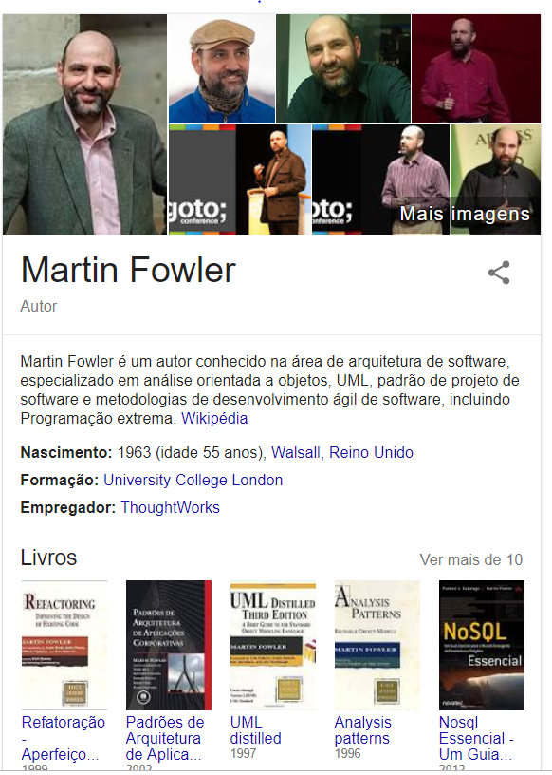
“If you can get today’s work done today, but you do it in such a way that you can’t possibly get tomorrow’s work done tomorrow, then you lose.”
“Poorly designed code usually takes more code to do the same things, often because the code quite literally does the same thing in several places.”

Slide 9
Improvements software architecture
Reusability through components instead of only services
Do not copy&Paste
Testability
Clear Diagnostics strategy
SOLID principles
Application of Design patterns
Documentation

Slide 10
“Talent wins games, but teamwork and intelligence wins championships.” – Michael Jordan

Slide 11
Improvements Team Culture
Communication
Methodology
Boarding process
Accountability
Collaboration
Continuous Feedback
Share Knowledge
Challenging and Fun

Slide 12
Q&A

